Slide 1





SHAPE THE FUTURE
MARCH 5-6, 2024

Slide 2



Facilitator
Recorder
Reporter
Round
Brainstorm

Slide 3






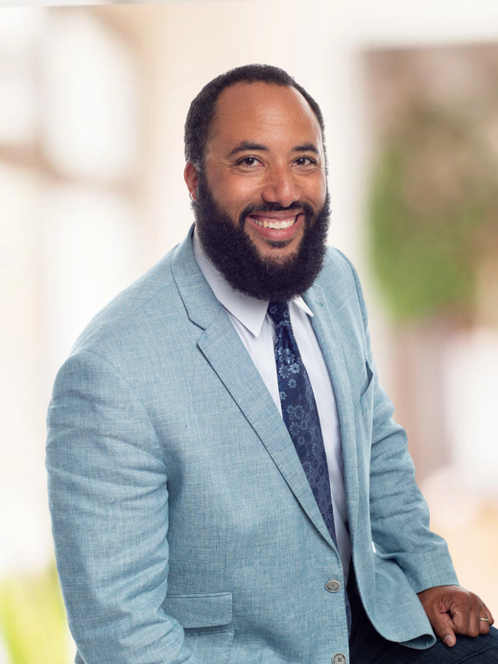

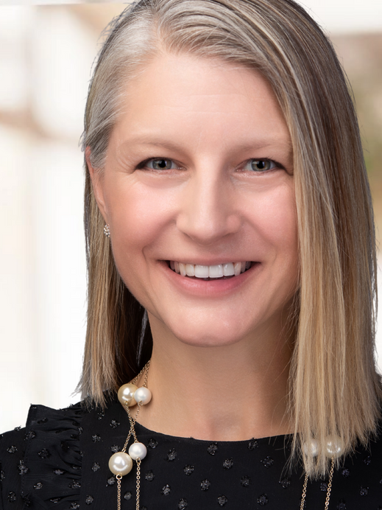

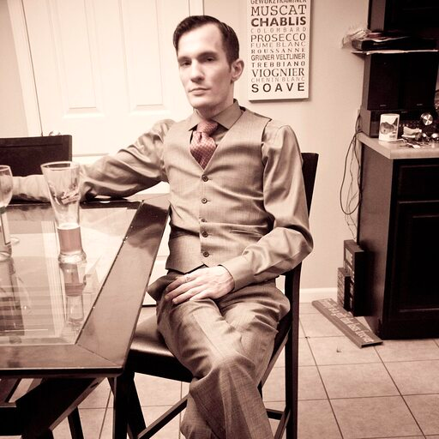


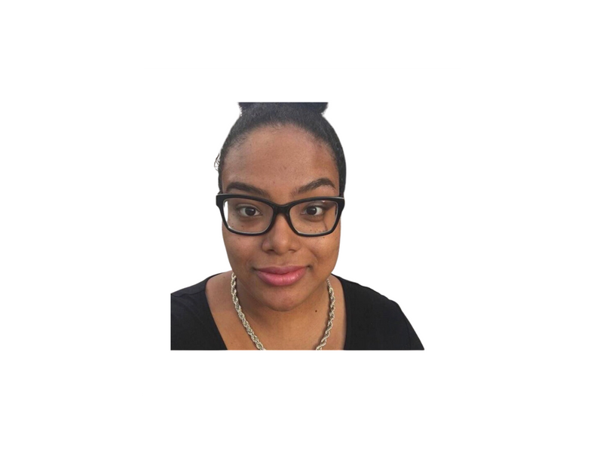
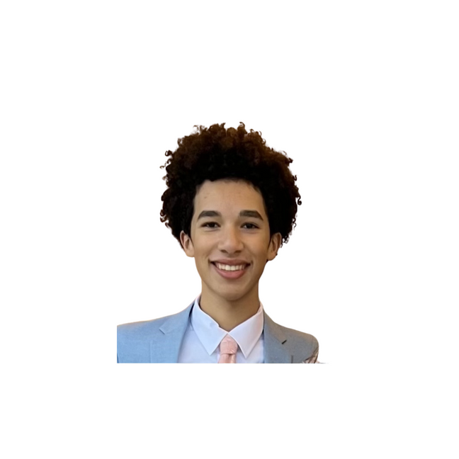

MEET THE TEAM!
JUSTIN
DEANNA
MEGAN
CHRISTINA
CHARLES
ZEPHANIAH
TIFFANY
ZION
SOFIE

Slide 4




JOY
COLLABORATION
GROWTH
LOVE

Slide 5








OUR LEARNING JOURNEY!
Building Resourcefulness:
Tricks on How to do MORE with LESS
The Time Crisis in DEI:
How the Lack of Time Contributes to Burnout among DEI Leaders
Shifting Context:
How to maintain integrity in changing times
Managing Power:
How do you Lead Across the Organization?
Unifying Visions:
Optimizing DEI Strategies for Greater Impact
Storytelling:
How To Package Your Vision to Inspire Others

Slide 6

TODAY!
(Free Included in Summit Ticket)
WORLD FOOD TOUR!
Meet us at 6:00 in the lobby to join our exclusive Multi-Cultural Dinner at 3rd Street Market Hall.
In collaboration with a diverse array of vendors,
we've crafted a multicultural feast!
WHEN: Dinner Tuesday, Meet in Lobby @6:00 p.m.
10 Minute (.04 Miles) Narrated History Walk
from St. Kate Lobby to the 3rd Street Market Hall*
ATTIRE: Casual + Walking Shoes!
#ShapeTheFutureSummit
*Let us know if you need
different accommodations!
Can’t wait to see you there!

Slide 7



Building Resourcefulness:
Tricks on How to do MORE with LESS

Slide 8


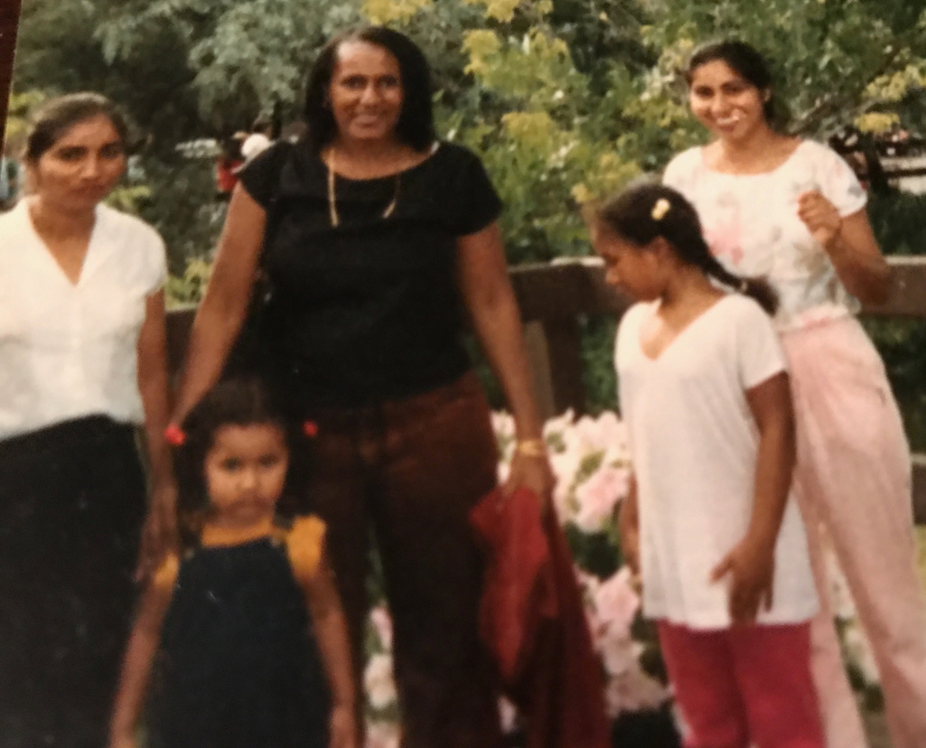
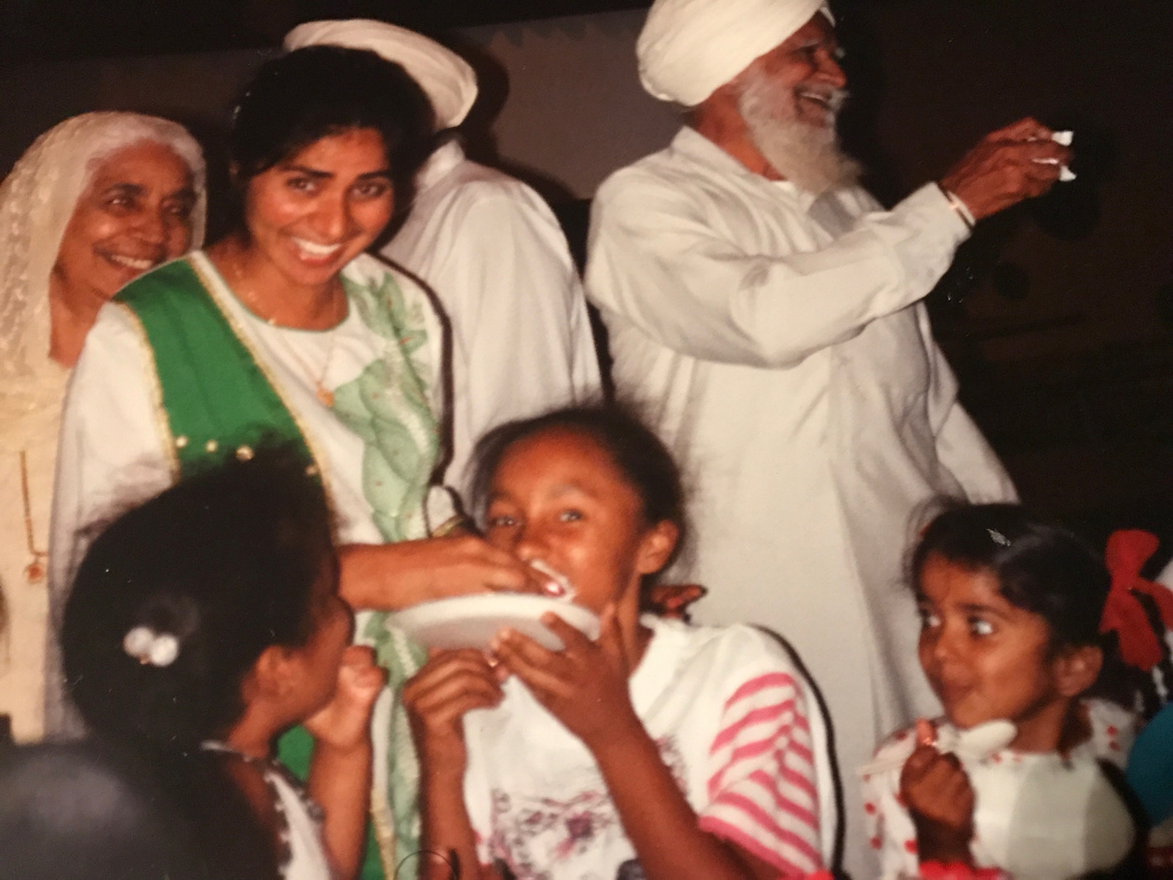

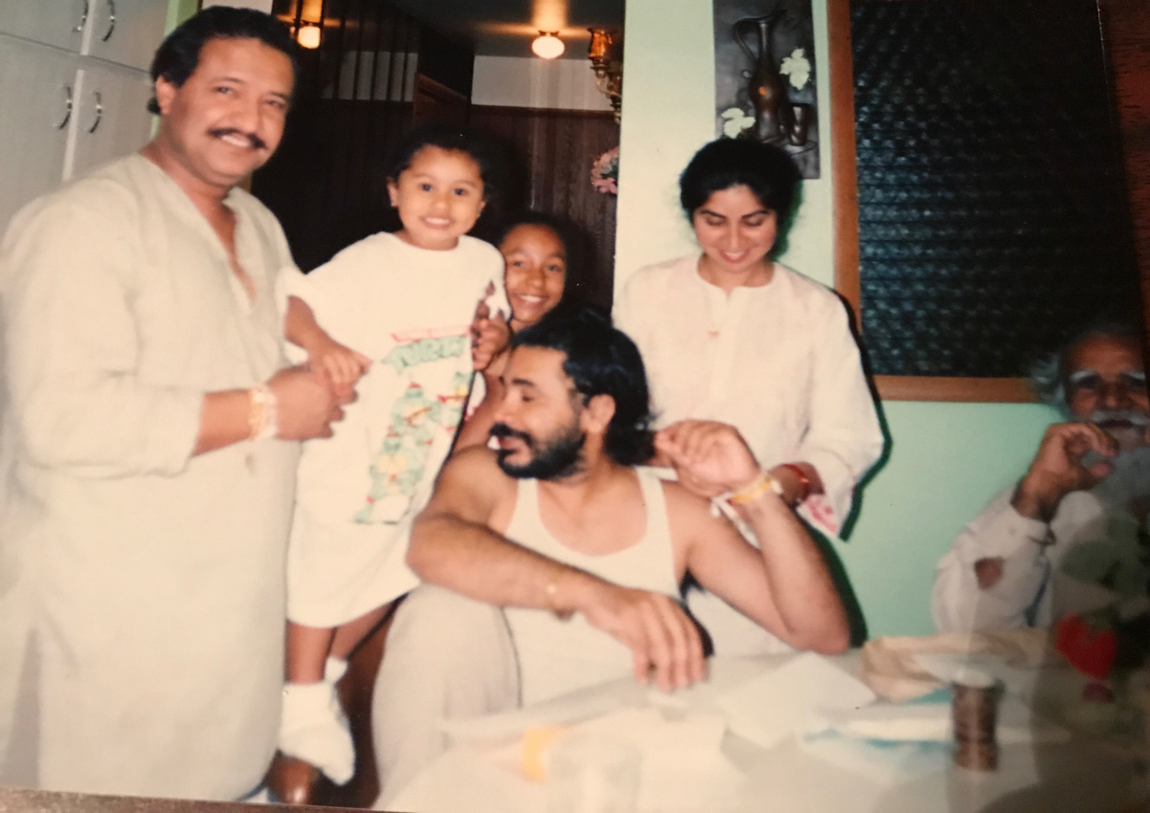
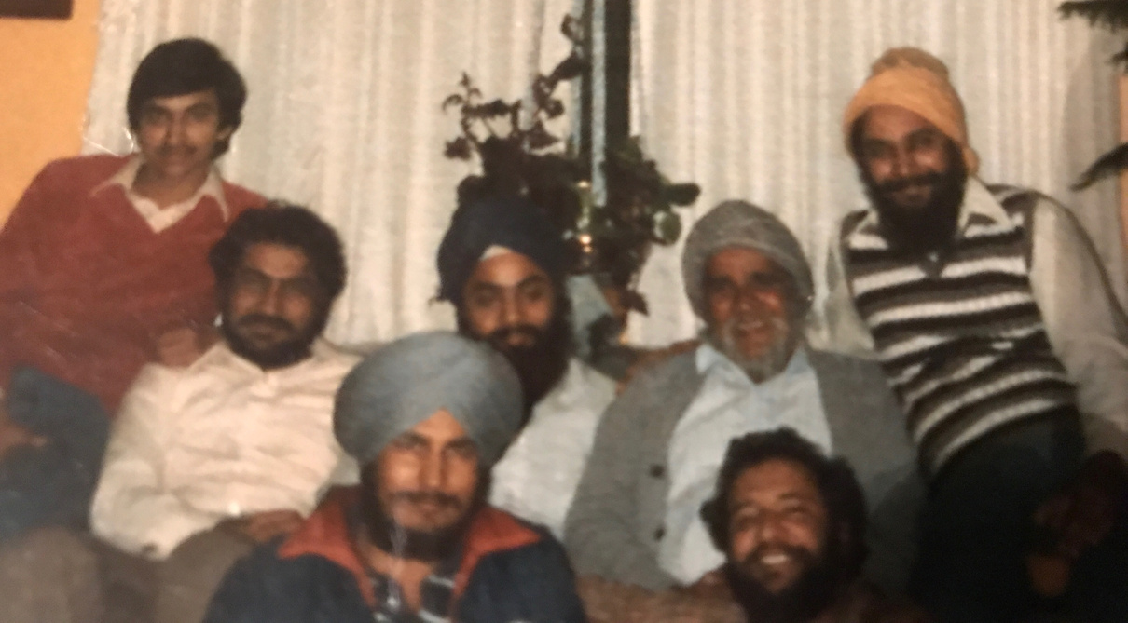

Slide 9



TIP 1
Note Assets

Slide 10




TIP 2
BUILD
RE-SOURCES

Slide 11



TIP 3
NOTE HAVE-TOS

Slide 12



TIP 4
MAKE FOLD-INS

Slide 13


PARTNER
MOVE
PARTNER
SHARE
BRAINSTORM

Slide 15


ENGAGEMENT CONTEST

Slide 16

The Time Crisis
How the Lack of Time Contributes to Burnout among DEI Leaders

Slide 17


“Wasting Time”

Slide 18

TIP 1
Name Your Seasons

Slide 19
TIP 2
PICK YOUR TIDE
  Ability to change
  Different workload

Slide 20
TIP 3
RIDE YOUR WAVE
  Rise (plan, surveys, focus groups, taskforce)
  Crest (implement, experiment, collect data)
  Rest (assess, report, celebrate, re-calibrate, reapply)

Slide 21
Facilitator
Recorder
Reporter
Round
Brainstorm

Slide 22
“Wasting Time”
  Name your seasons
  Pick your tide
  Ride your wave

Slide 23
ENGAGEMENT CONTEST

Slide 24


Shifting Contexts
How to maintain integrity in changing times

Slide 25
TIP 1: KNOW YOUR BLOCKS
  Context, audience, purpose
  Intent vs. impact
  Vocab

Slide 26
TIP 2: TILT YOUR MIRROR
  Surrender universals
(posters, pictures, “shoulds”)
  See org values
(mirror of who you are)
  Tilt them upward
(align who you could become)

Slide 27
TIP 3: PREP YOUR FAQS
  Own the narrative
  Craft scripts
  Ready responses

Slide 28
PARTNER
MOVE
PARTNER
SHARE
BRAINSTORM

Slide 29
Shifting Contexts
1. Know your blocks
2. Tilt your mirror
3. Prep your FAQs

Slide 30


Ask Us Anything

Slide 31
Facilitator
Recorder
Reporter
Round
Brainstorm

Slide 32



RECAP
TOMORROW
NOW
Resourcefulness
Time
Context
AMA
Breakfast
Welcome
Power
Vision
Storytelling
Forward
Rest
MKE

Slide 33
SHAPE THE FUTURE
MARCH 5-6, 2024

Slide 34
Facilitator
Recorder
Reporter
Round
Brainstorm

Slide 35
OUR LEARNING JOURNEY!
Building Resourcefulness:
Tricks on How to do MORE with LESS
The Time Crisis in DEI:
How the Lack of Time Contributes to Burnout among DEI Leaders
Shifting Context:
How to maintain integrity in changing times
Managing Power:
How do you Lead Across the Organization?
Unifying Visions:
Optimizing DEI Strategies for Greater Impact
Storytelling:
How To Package Your Vision to Inspire Others

Slide 36
ENGAGEMENT CONTEST

Slide 37

Managing Power
How do you Lead Across the Organization?

Slide 38
TIP 1
LAUNCH A LISTENING TOUR
  Gather data, rigor, and regularity
  From members, customers, and competitors
  Broaden context

Slide 39
TIP 2
CO-CREATE WITH DECIDERS
  Don’t seek approval (it’s too formal and late)
  Seek advice (when informal and early)
  Seek assistance

Slide 40
TIP 3
MAKE IT EASY
  Pilot
  Fold-in
  Micronorm

Slide 41



PRE-SUADE
  Who’s on your listening tour?
  What would you say to invite deciders to co-create?
  What would you do to make it easy for deciders?

Slide 42
Managing Power
How do you Lead Across the Organization?

Slide 43



OUR OFFERINGS!
WORKSHOPS
KEYNOTES
COACHING
More information in
your workbook!

Slide 44







GROUNDBREAKERS RETREAT
"Groundbreakers" refers to professionals from socio-economic backgrounds that make them "the firsts," "the fews," and "the onlys" in their workplaces.
Join us in Milwaukee, WI, September 27-28th for an inspiring two-day retreat focused on transcending workplace barriers!
Spots will be first come, first served so scan this code today to get the latest updates sent directly to you!

Slide 45
ENGAGEMENT CONTEST

Slide 46

Unifying Visions
Optimizing DEI Strategies for Greater Impact

Slide 47
ENGAGEMENT CONTEST

Slide 48

Storytelling
How To Package Your Vision to Inspire Others

Slide 49
TIP 1
REGROUP
  Build “good” to “gooder”
  Construct a collective
(us, our, we, family, team)
  Discuss org as its own society

Slide 50
TIP 2
REFRAME
  Overcome novelty bias
  Highlight the commonplace
  Move from add-on AND fold-in to transform
  “This thing we’re already doing is also inclusion”

Slide 51
TIP 3
PERSONALIZE
  Diversify medium
  Emphasize process
(move from “I am” to “I do”)
  Model vulnerability

Slide 52

MODEL VULNERABILITY
  Who are you?
  What are your professional strengths?
  When it comes to being inclusive, what do you struggle with?
  How are you working on it?
  What do you hope?

Slide 53


PARTNER
MOVE
PARTNER
SHARE
BRAINSTORM

Slide 54
Storytelling
How To Package Your Vision to Inspire Others

Slide 55
FORWARD

Slide 56
OUR LEARNING JOURNEY!
Building Resourcefulness:
Tricks on How to do MORE with LESS
The Time Crisis in DEI:
How the Lack of Time Contributes to Burnout among DEI Leaders
Shifting Context:
How to maintain integrity in changing times
Managing Power:
How do you Lead Across the Organization?
Unifying Visions:
Optimizing DEI Strategies for Greater Impact
Storytelling:
How To Package Your Vision to Inspire Others

Slide 57







SPONSORS
OUR

Slide 58
FORWARD

